Slide 1

2019 in Graphs
Professor David Warton
Stats Central

Slide 2
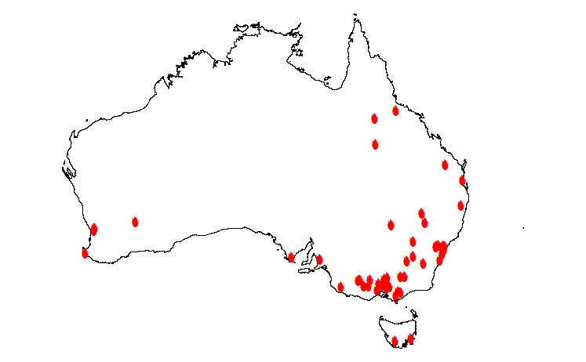
BUSHFIRE DISASTER
thanks to Attorney General’s department, data.gov.au

Slide 3
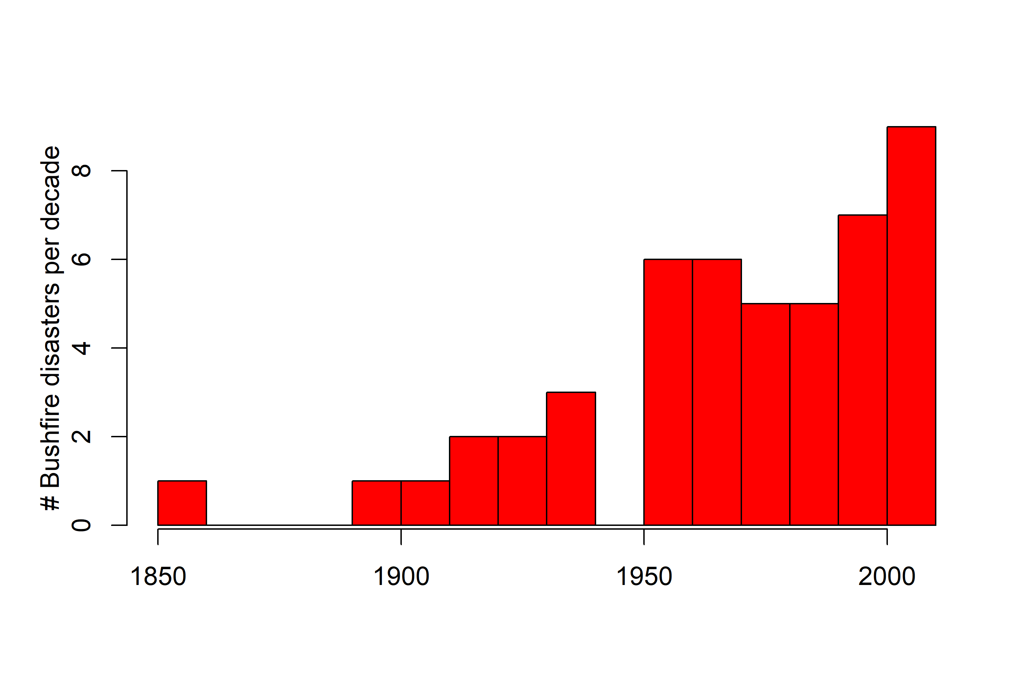
BUSHFIRE DISASTER
thanks to Attorney General’s department, data.gov.au

Slide 4
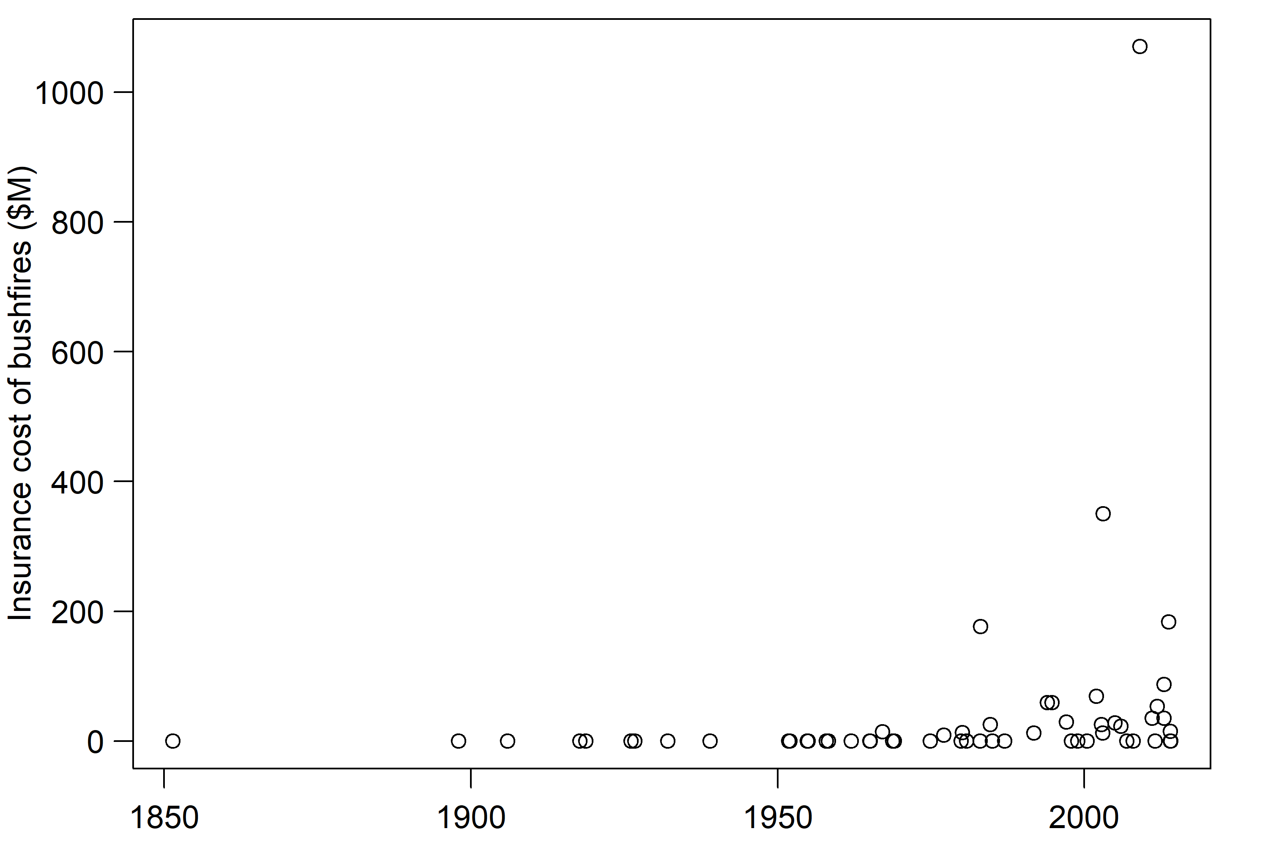
BUSHFIRE DISASTER
thanks to Attorney General’s department, data.gov.au

Slide 5
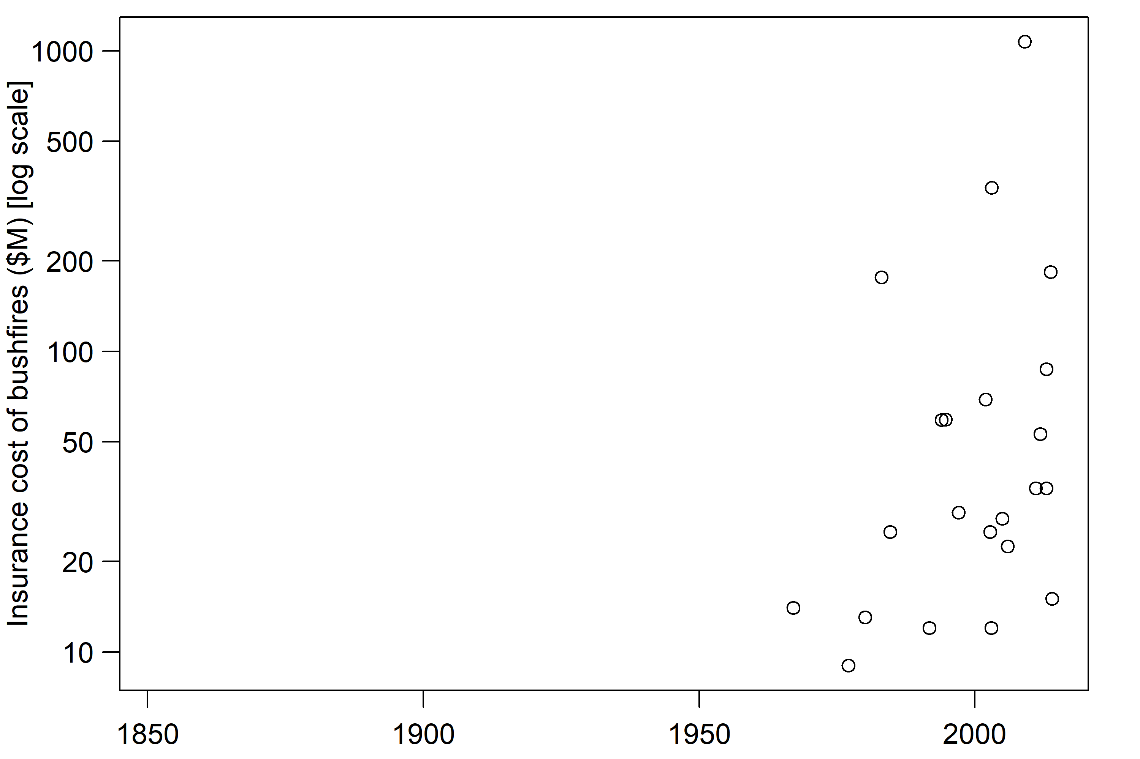
BUSHFIRE DISASTER
thanks to Attorney General’s department, data.gov.au

Slide 6
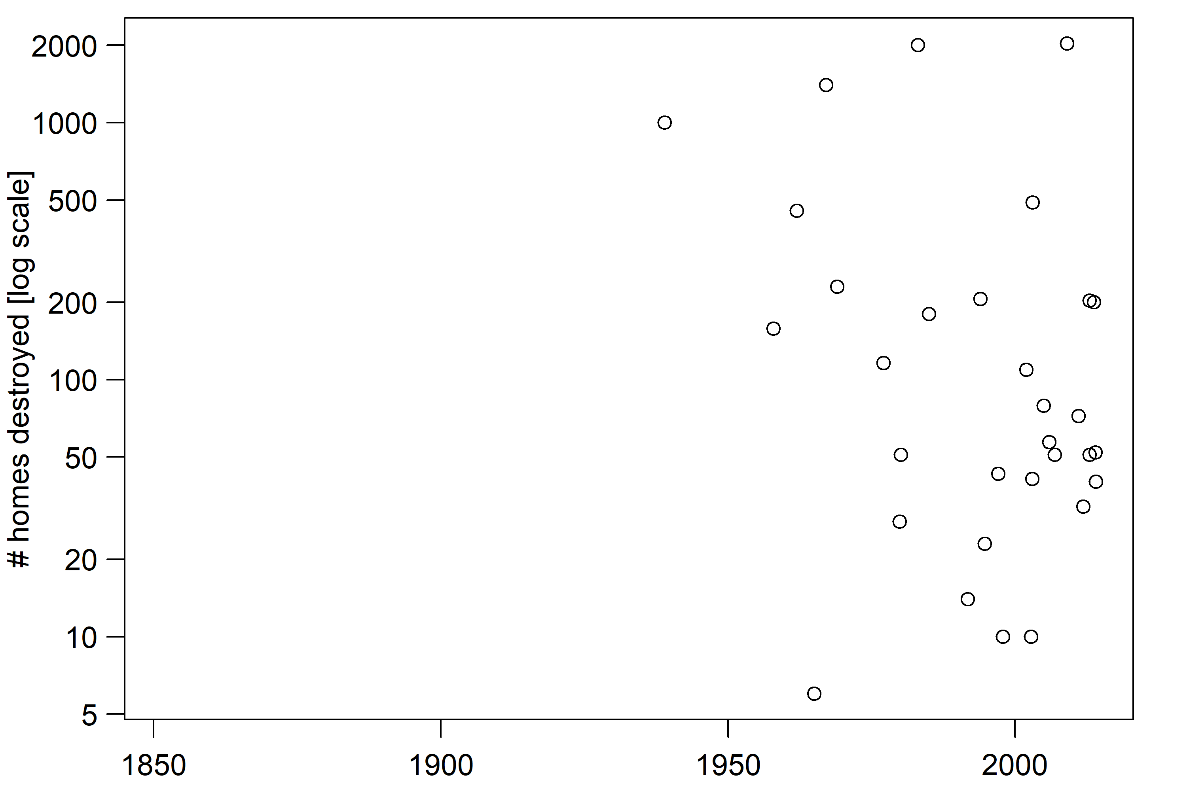
BUSHFIRE DISASTER
thanks to Attorney General’s department, data.gov.au

Slide 7
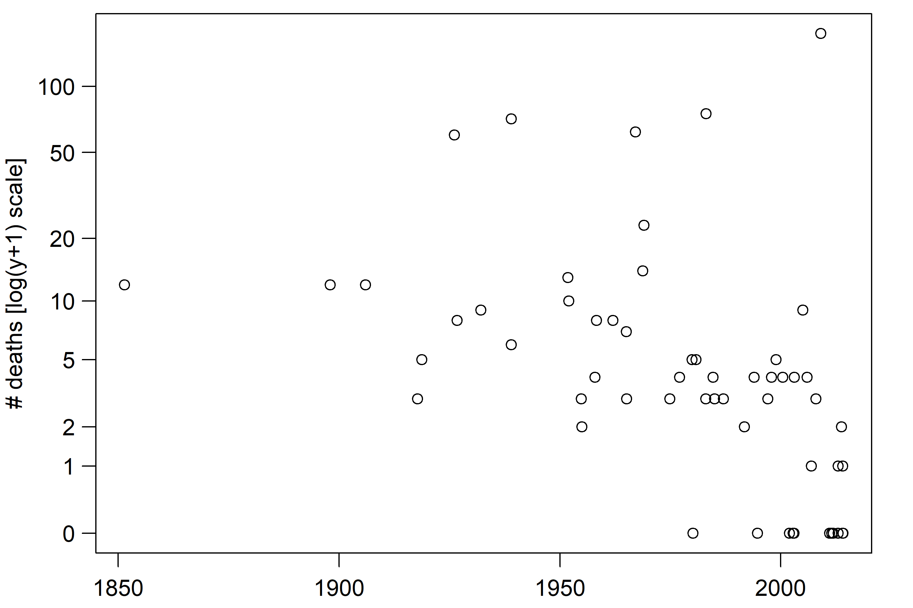
BUSHFIRE DISASTER
thanks to Attorney General’s department, data.gov.au

Slide 8
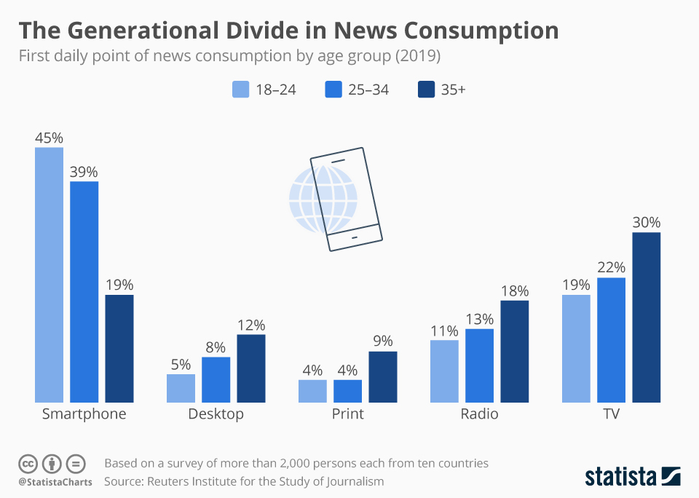
WHERE DO YOU GET YOUR NEWS FIX?

Slide 9
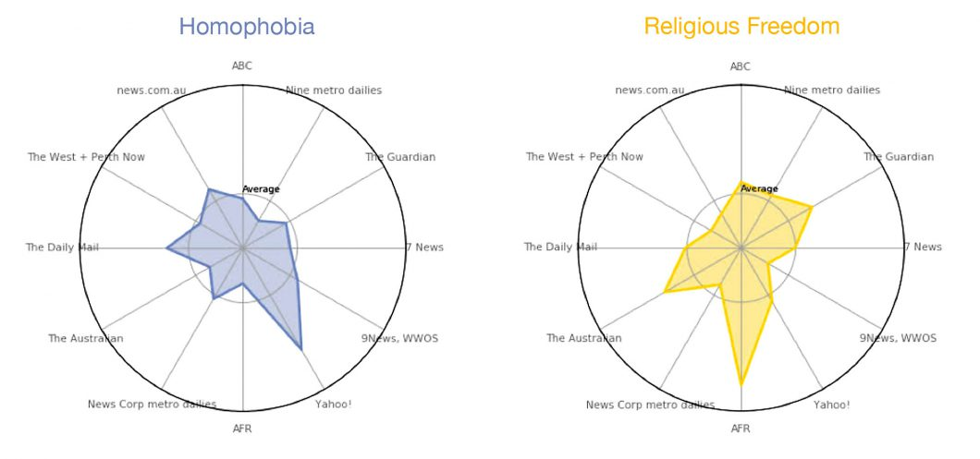
NEWS ON FOLAU
thanks to smallmultiples.com.au

Slide 10
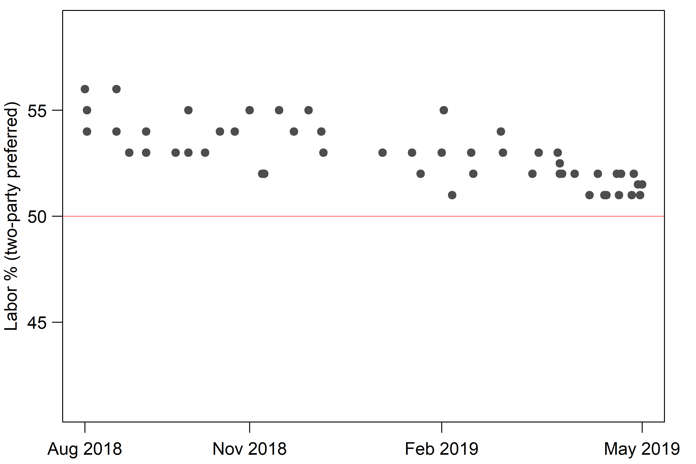
POLL FAIL
thanks to Wikipedia for data

Slide 11
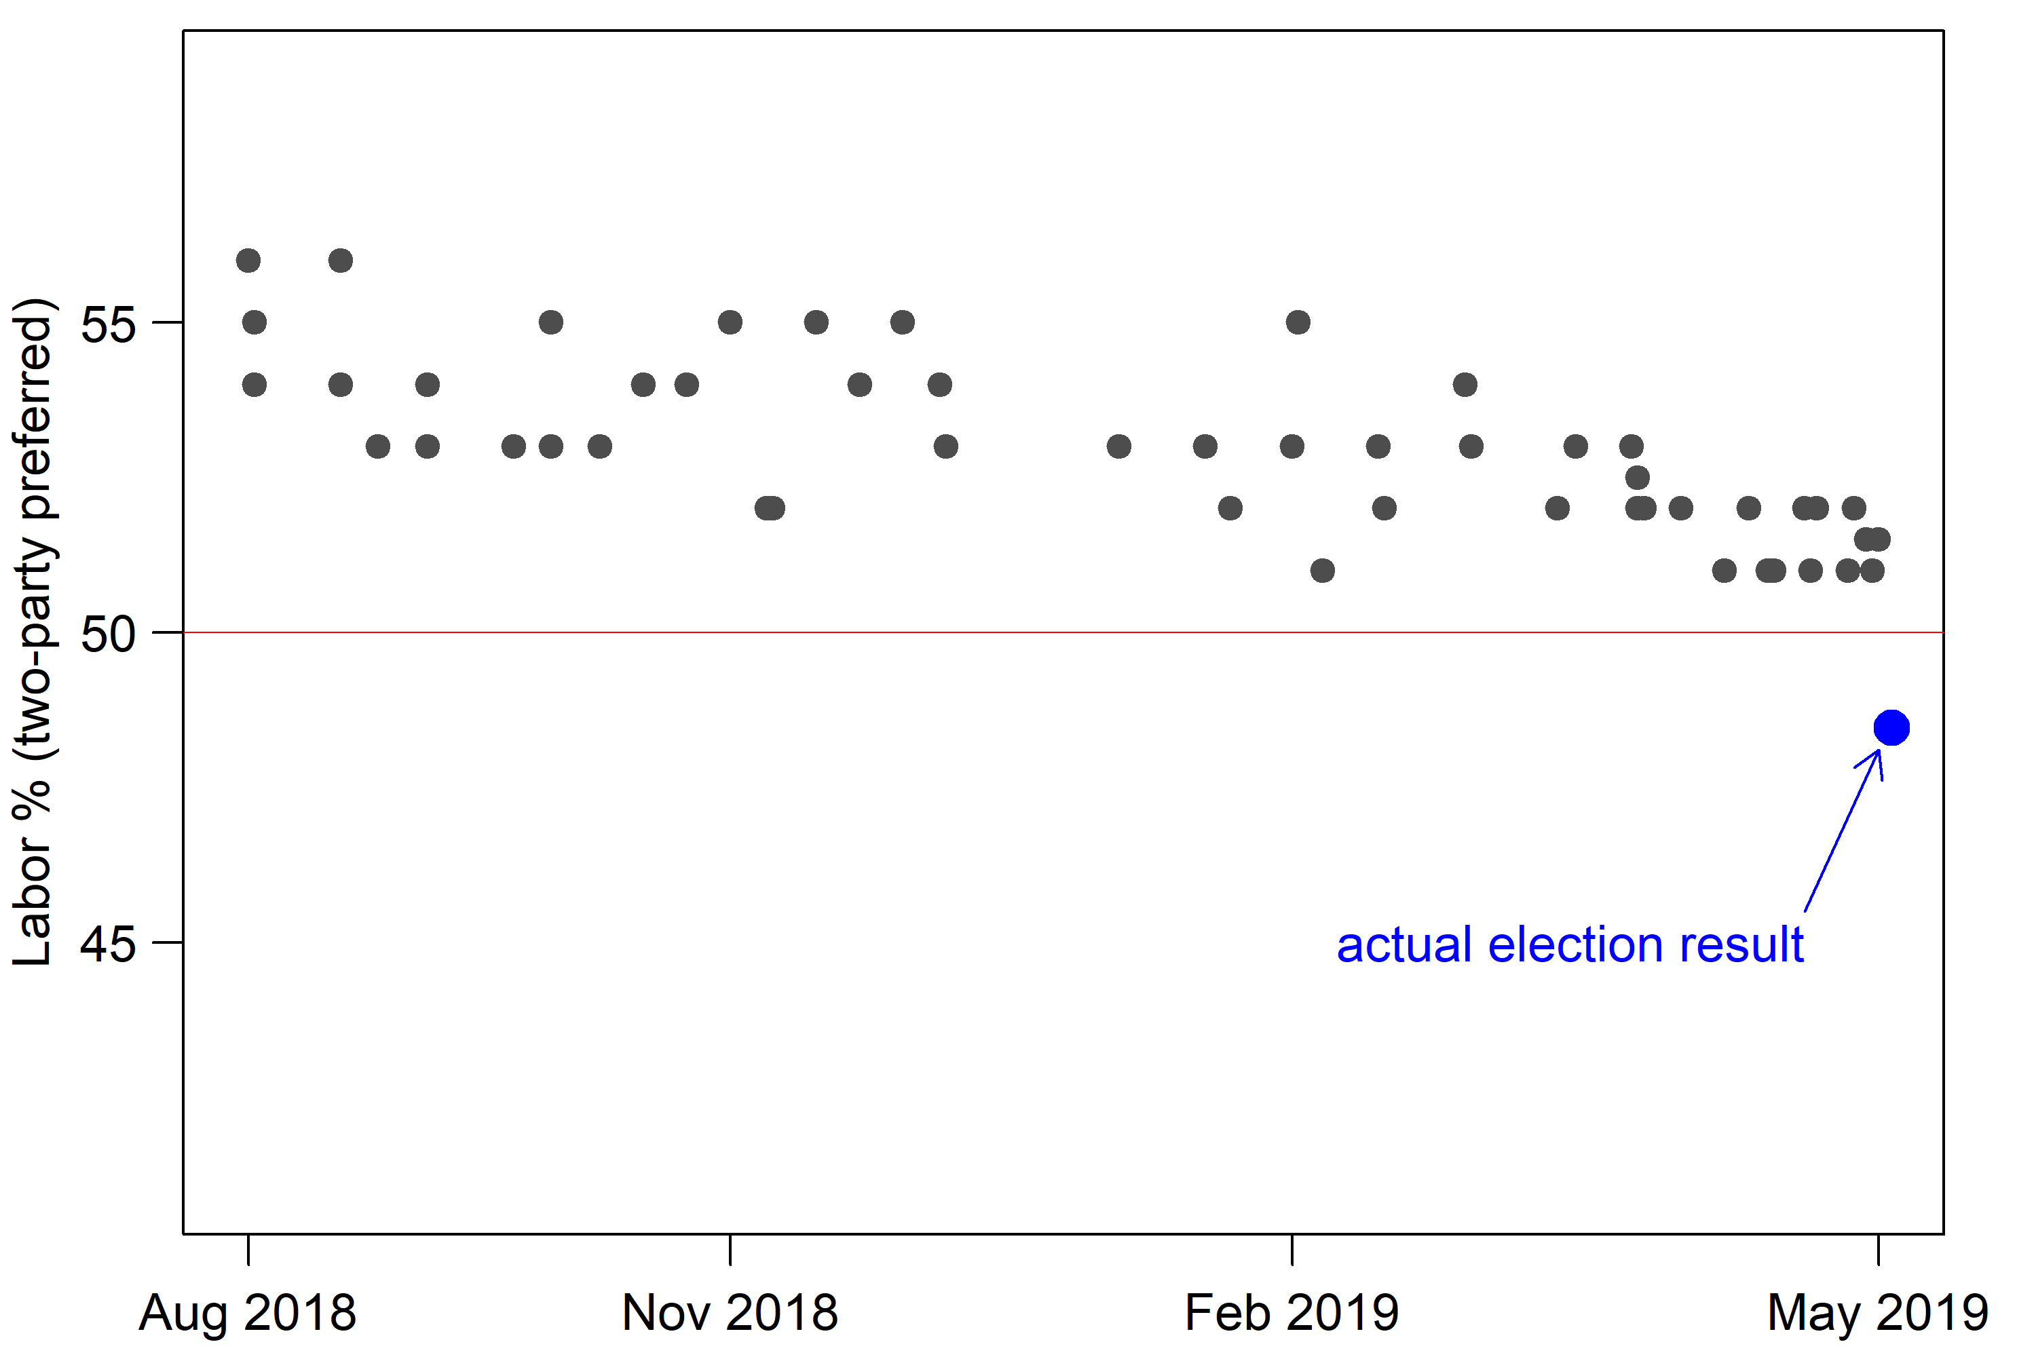
POLL FAIL
thanks to Wikipedia for data

Slide 12
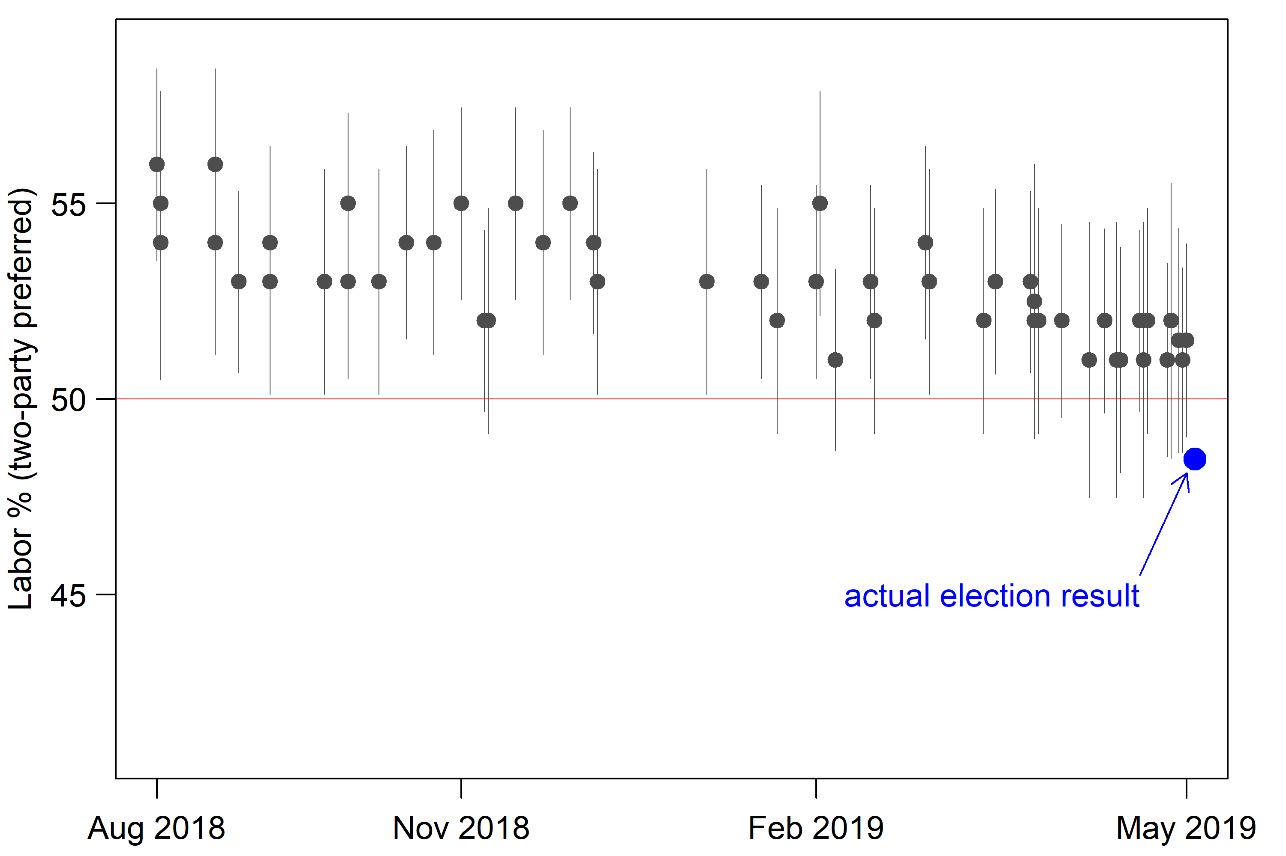
POLL FAIL
thanks to Wikipedia for data

Slide 13
POLL FAIL
thanks to Wikipedia for data

Slide 14
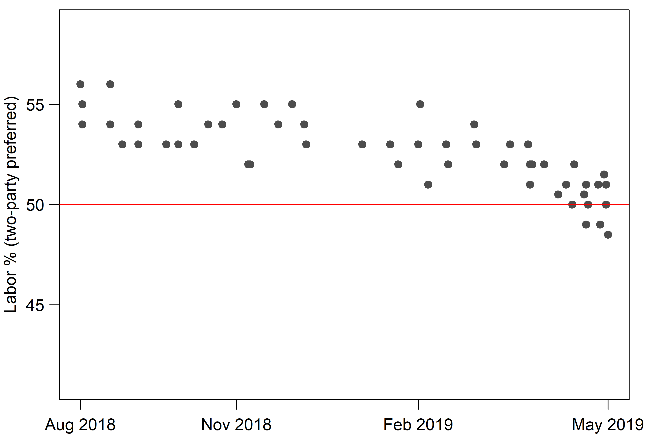
POLL FAIL
thanks to Wikipedia for data

Slide 15
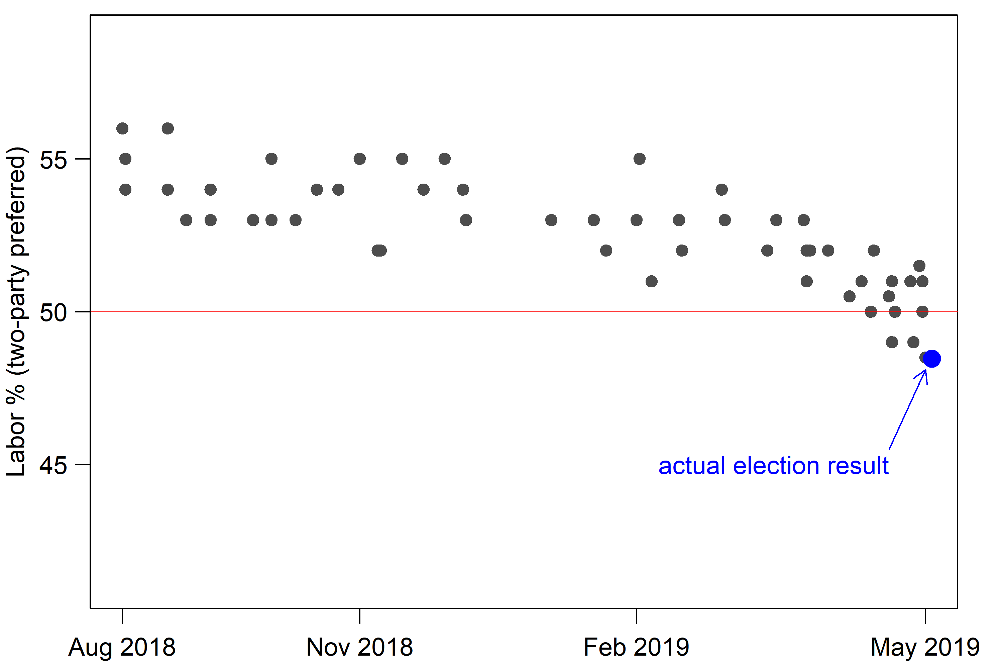
POLL FAIL
thanks to Wikipedia for data

Slide 16
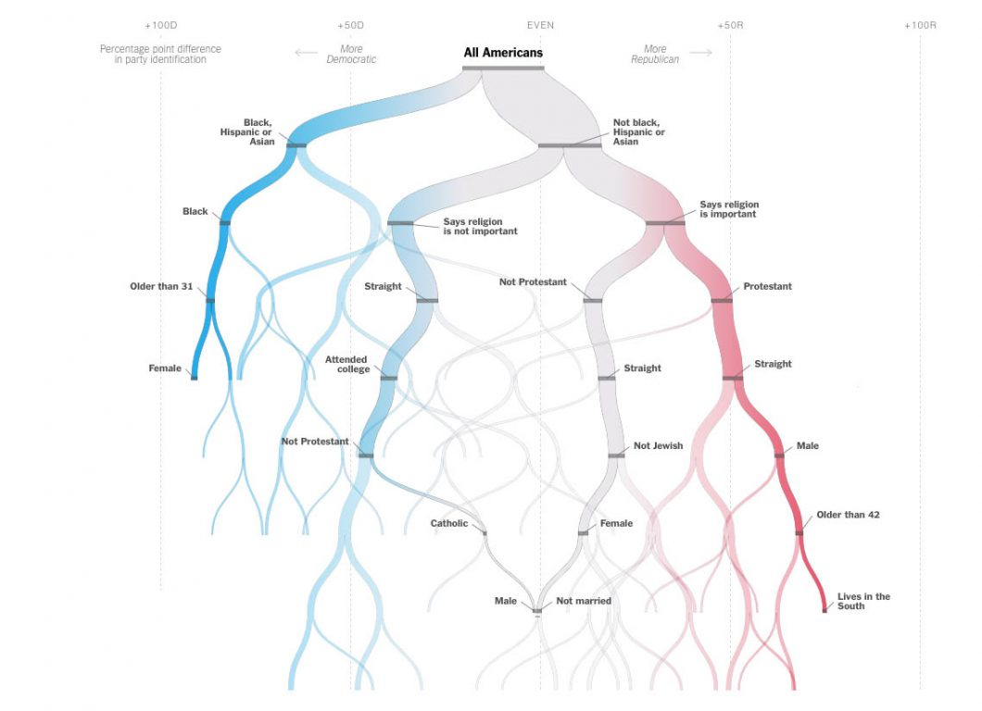
A DIVIDED COUNTRY
thanks to smallmultiples.com.au

Slide 17
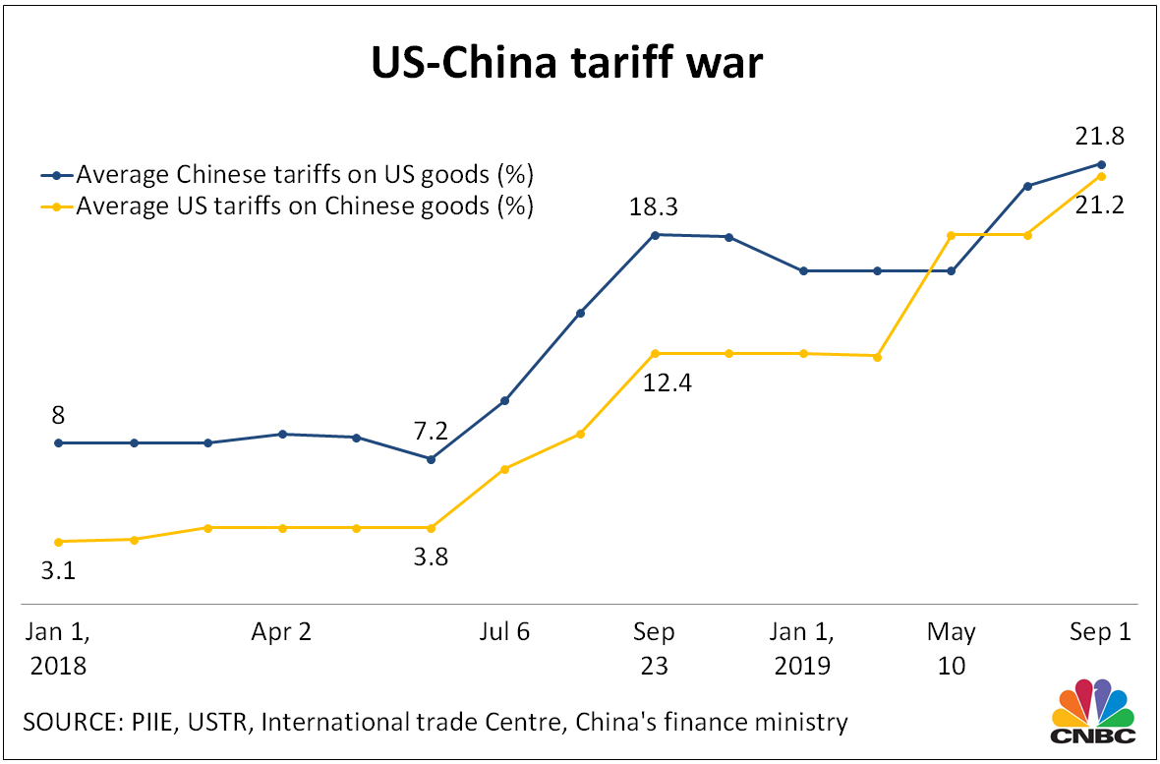
TRADE WAR

Slide 18
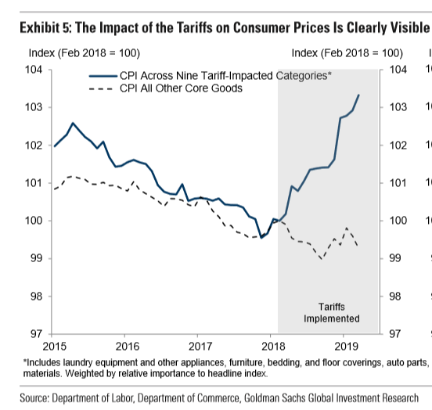
TRADE WAR

Slide 19
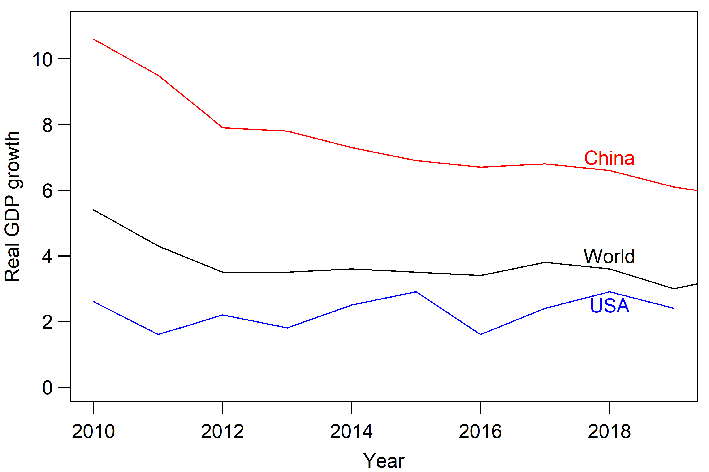
TRADE WAR
thanks to IMF for data

Slide 20
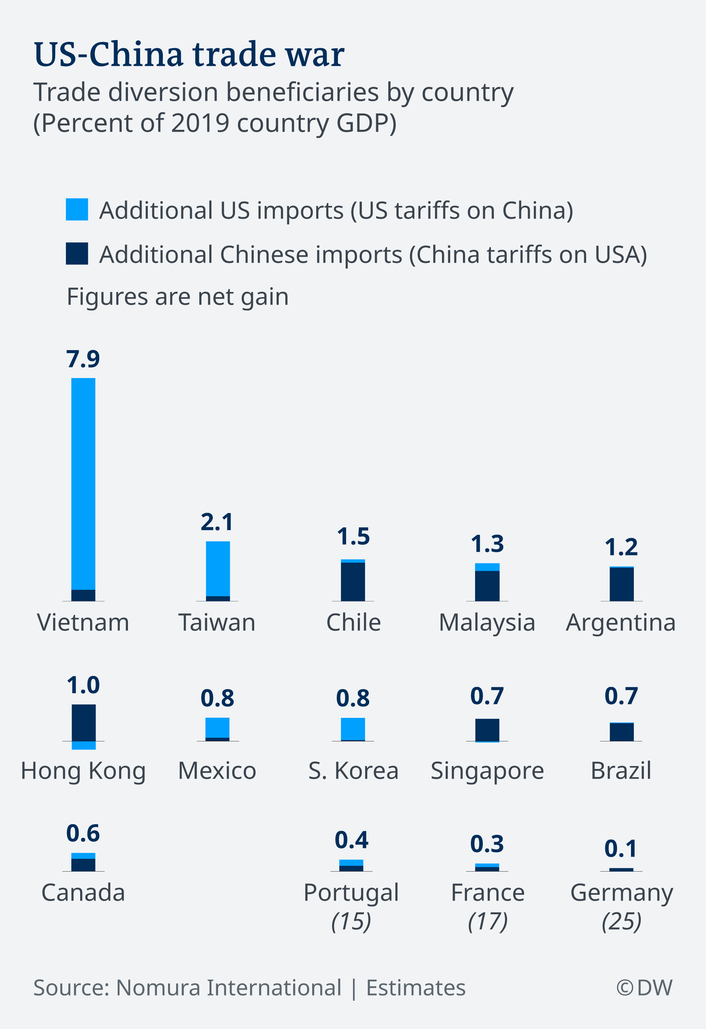
TRADE WAR

Slide 21
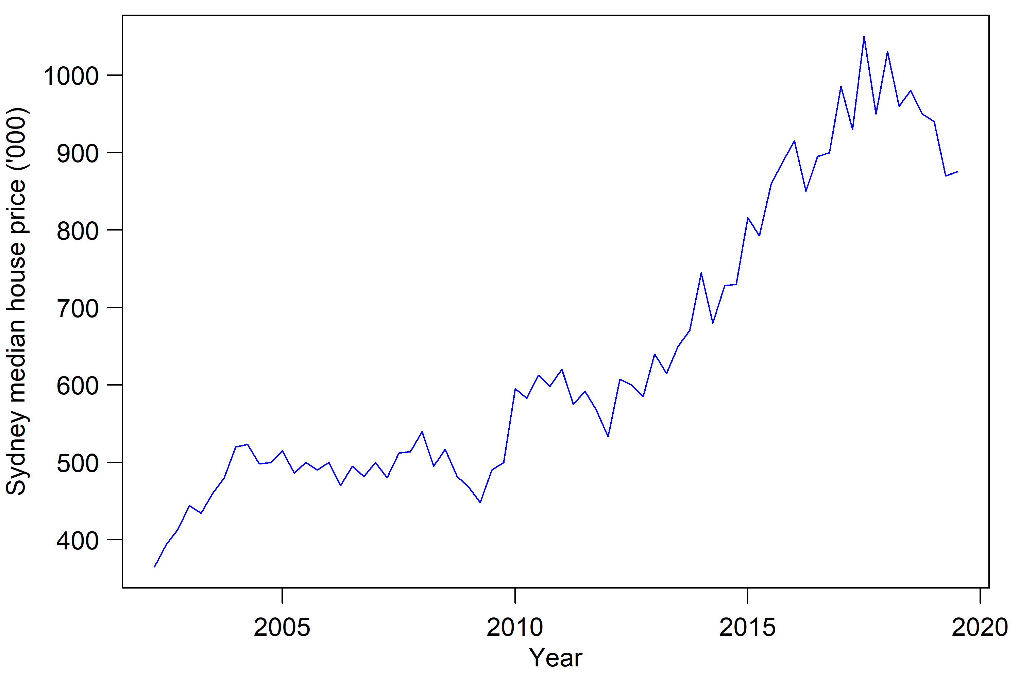
SAFE AS HOUSES
thanks to Australian Bureau of Statistics for data

Slide 22
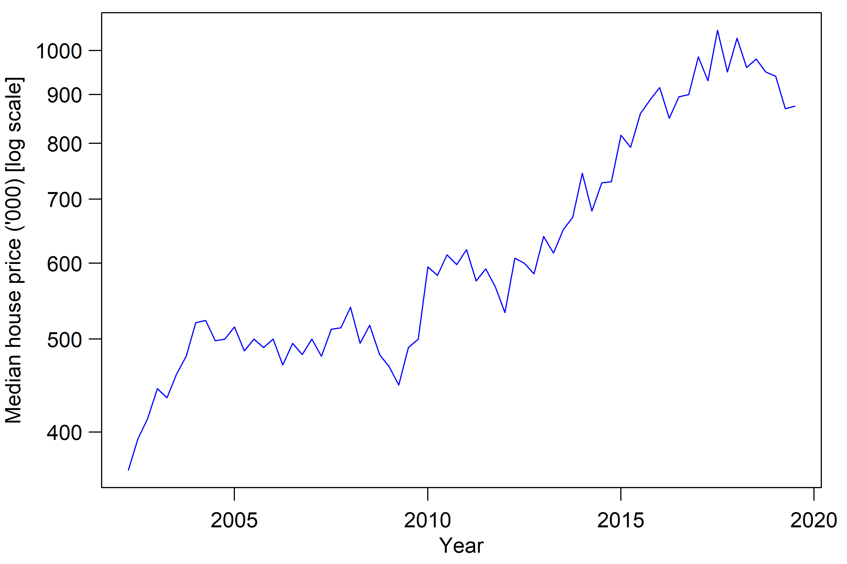
SAFE AS HOUSES
thanks to Australian Bureau of Statistics for data

Slide 23


Slide 24
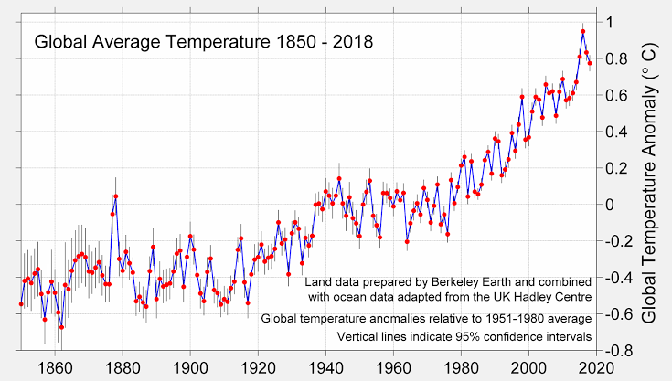
http://berkeleyearth.org/

Slide 25
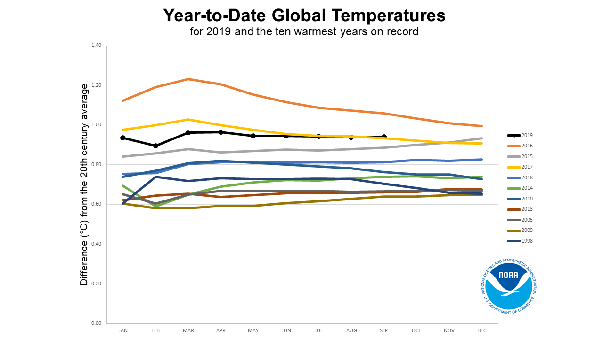

Slide 26
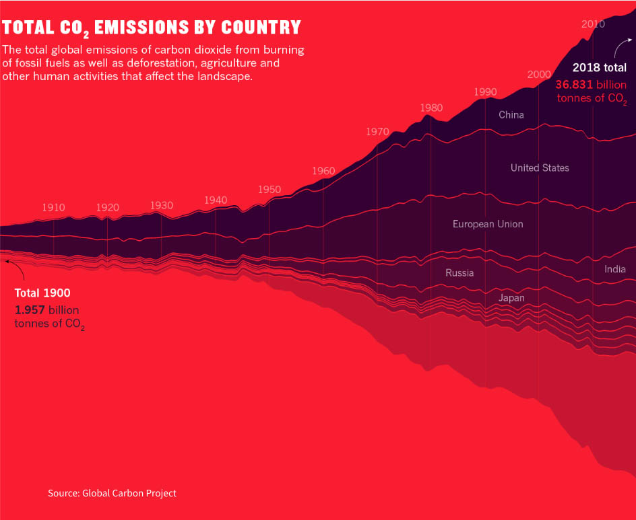
CLIMATE EMERGENCY

Slide 27
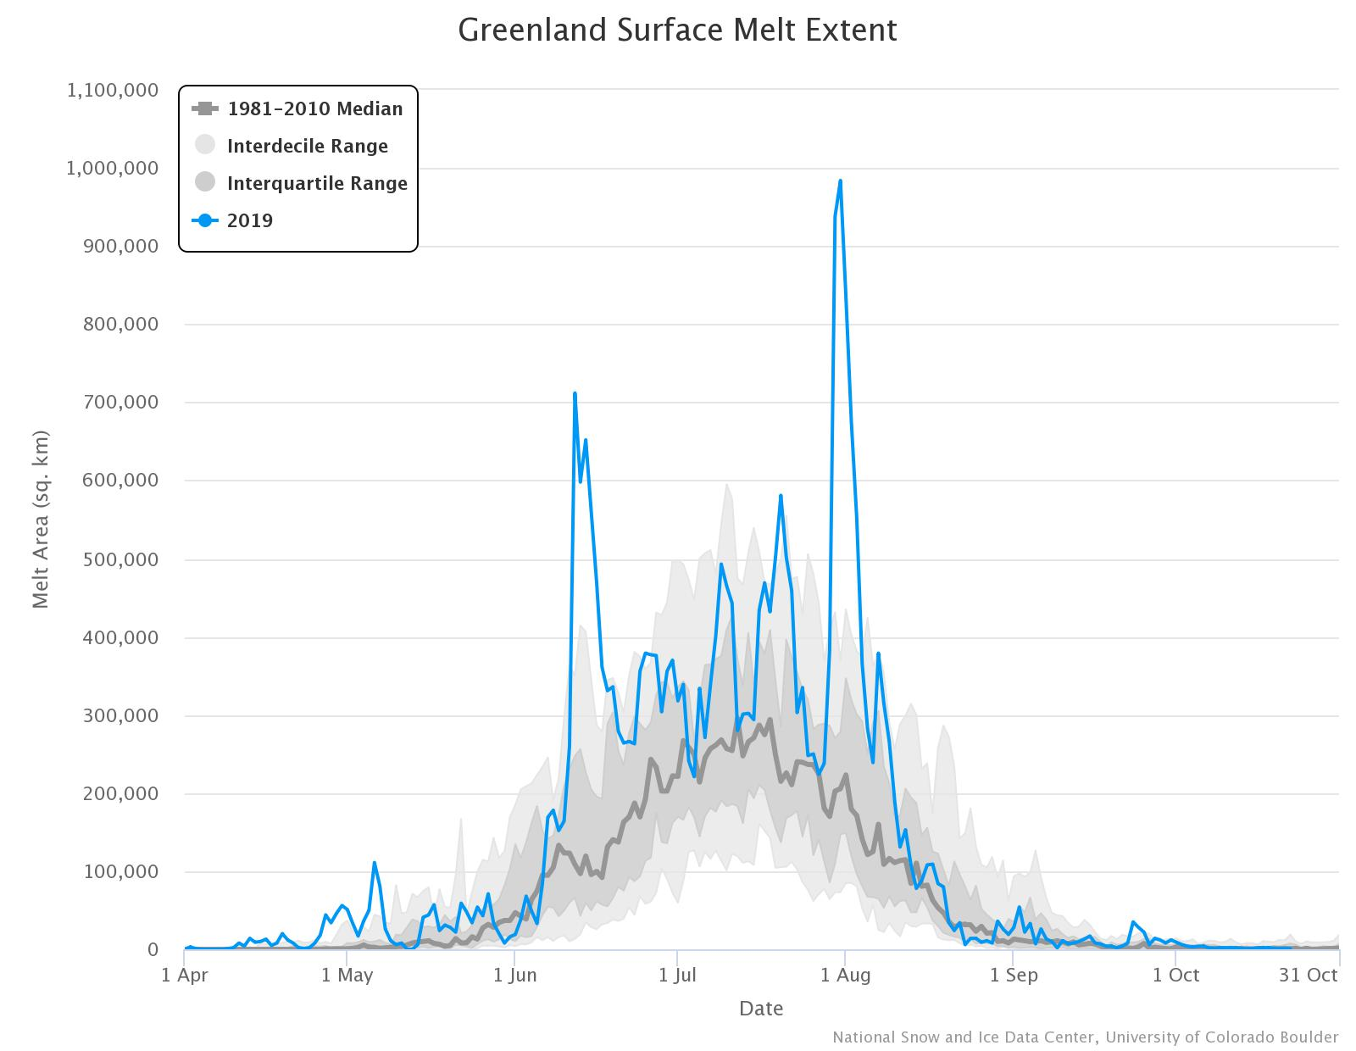
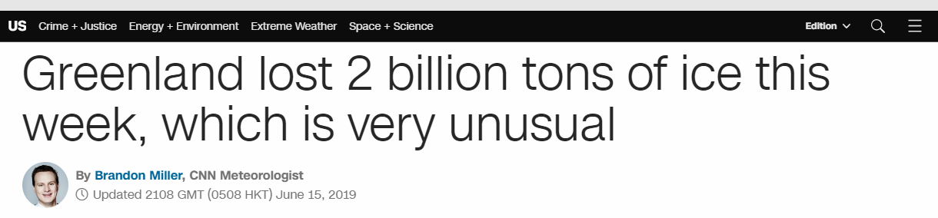
CLIMATE EMERGENCY

Slide 28
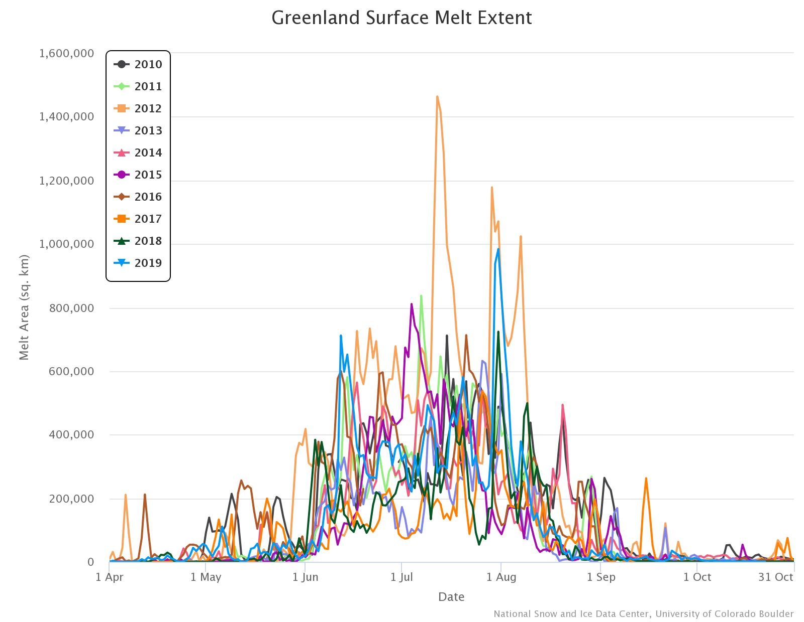
CLIMATE EMERGENCY

Slide 29
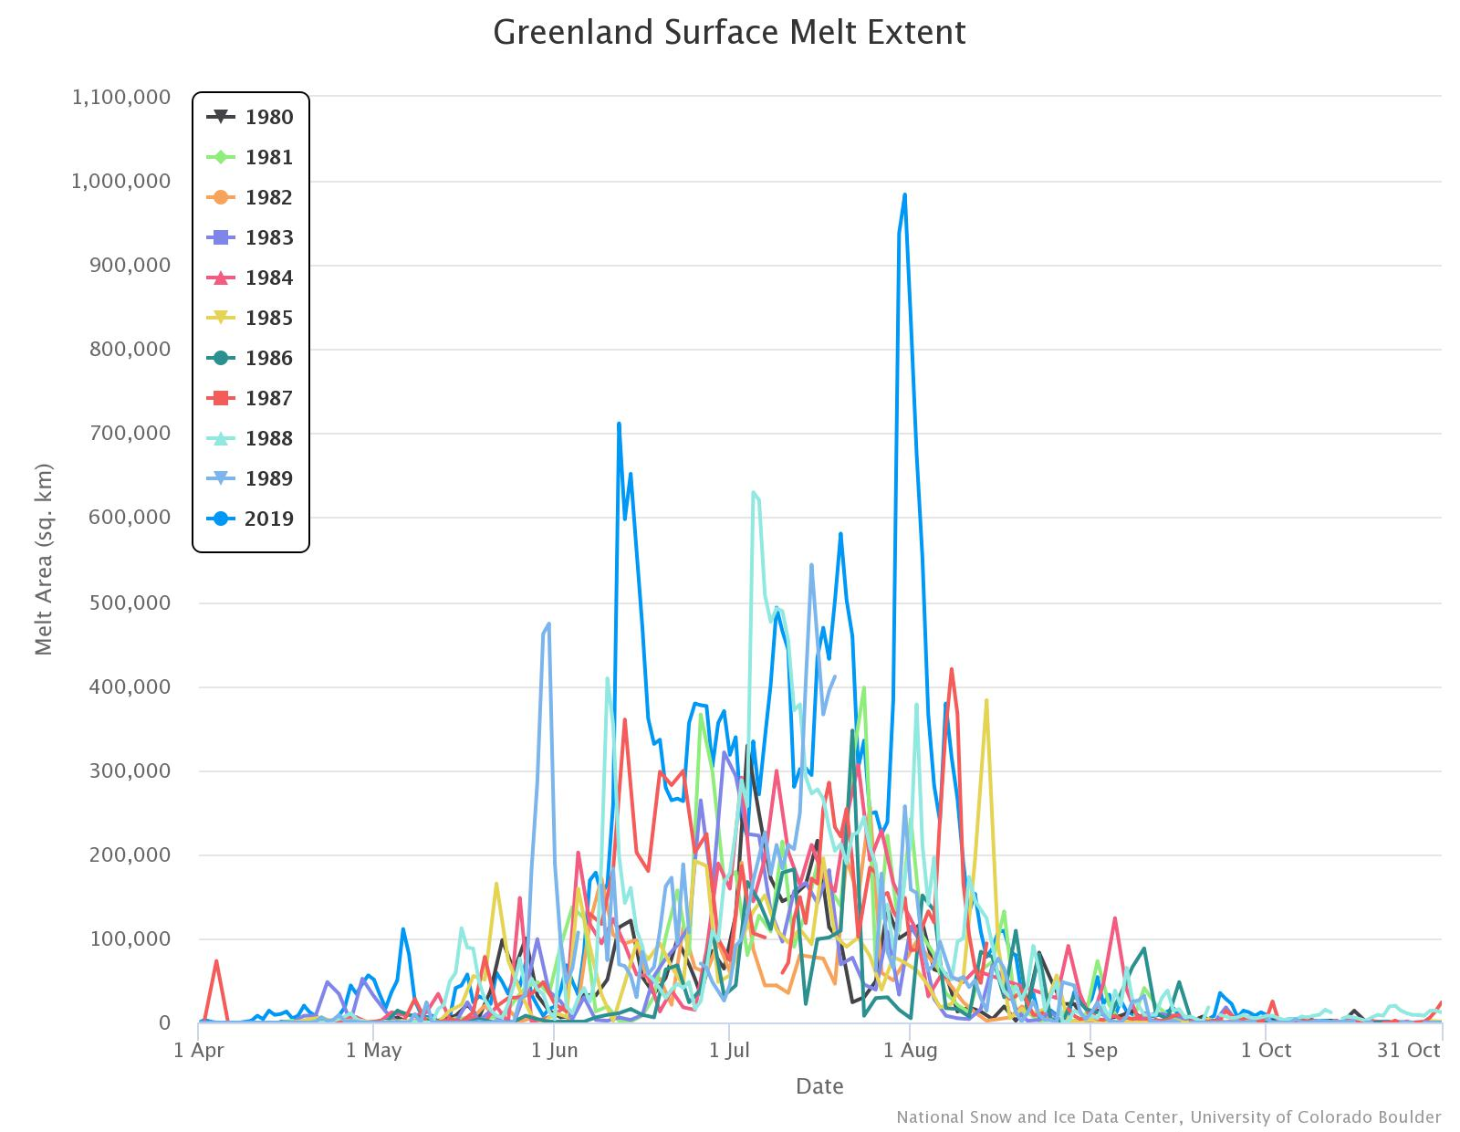
CLIMATE EMERGENCY

Slide 30
CLIMATE EMERGENCY

Slide 31
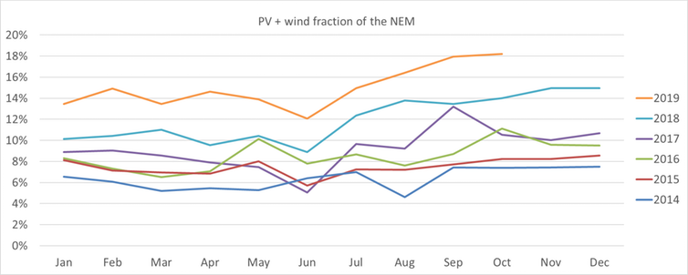
CLIMATE EMERGENCY

